Slide 1
NSF Computer Programming!
(week 1)

Slide 2
What to expect
10 weeks
Basics of programming
(after the class you can build your own projects!)
Python
Treated like a college class, you get what you put into the course!
Lecture
Ask questions whenever you have trouble, I am here to help!
Homework
You should do it ☺
It’s not intended to be very difficult, but to practice your skills

Slide 3
Things you should have already done
Open repl.it and run the tester file

Slide 4
About Me
Ishita Date
Senior at Georgia Tech, go jackets!
Graduating in December
Interested in data analytics and machine learning
1st coach with NSF

Slide 5
What is Computer Programming?
You, the programmer, are giving the computer exact instructions of what to do. These instructions are very specific and are read very literally.
Goal: Make the computer accomplish a task.
Why it’s not as easy as it sounds: There’s a lot of technical language and strange syntax.

Slide 6
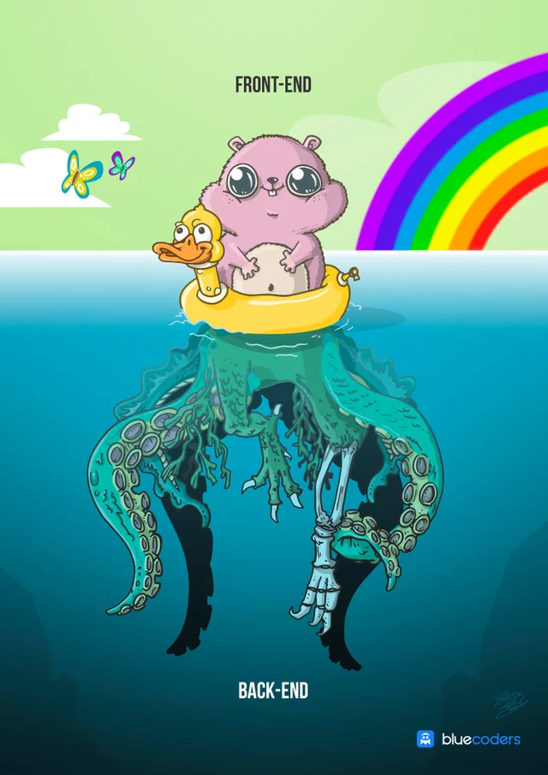
Frontend vs Backend
Frontend = the stuff the user sees
Backend = the stuff that happens behind-the-scenes so the users can do stuff
Python does both
Both can be difficult
Notes:
Image from reddit

Slide 7
Let’s start!

Slide 8
Python
Easy to understand and versatile
Well-used
Dropbox’s front-end
Netflix’s recommendation algorithm
How to run a file
Script vs. terminal
python + file name
Code basics
Printing
Comments

Slide 9
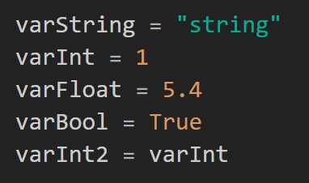
Variables
Definition: Variables are used to stored information, and can be manipulated in a computer program
Naming
No random symbols
Conventions
Key Words
No upper case
Can be referenced later
Committing to memory

Slide 10
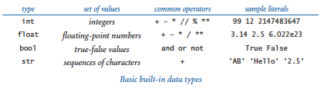
Data types

Slide 11
A Math Problem
Steve has 6 apples. The following things happen in order:
He eats 3 of them = 3
Gives one third of them away = 2
He goes to the store. The store has 10 apples and he buys half of them
He has twice as many bananas as apples
How many bananas does Steve have?
Notes:
Activity: Talk this through with the students

Slide 12
~Interlude~

Slide 13
Navigating Folder
ls –- list files in current directory
cd –- takes back to the home directory
cd + ‘folder’ --- enter into the folder

Slide 14
This is all some pretty cool stuff. But making sure your code is legible is pretty important. You don’t want to write code for an hour, and then come back the next day and spent two hours trying to figure out what you wrote last time.
You’ll end up rereading your code at some point in the future - save yourself the trouble of trying to figure out what it says by:
Making it legible
Using comments
Spacing things out when it makes sense
Don’t repeat what you don’t need to

Slide 15
How to debug
Errors happen. Things don’t go the way you’d like them to.
Go through your code line by line and explain what it does to yourself or someone else
Check syntax - are you doing something that makes sense?
Use the debugger
Take a break and read it later
Eat
Sleep (these are important)

